Slide 1
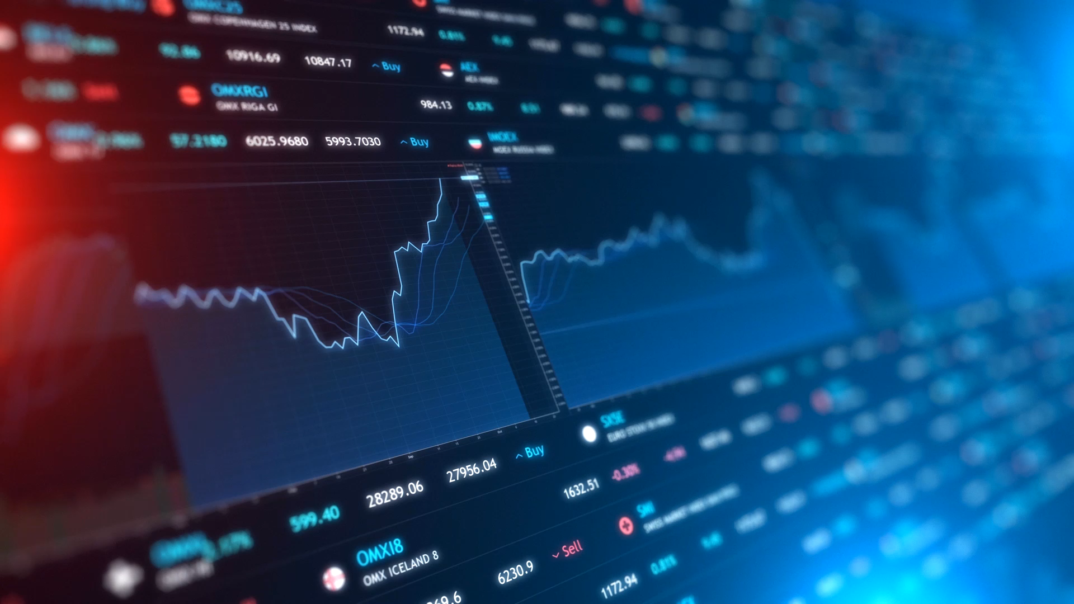
Trend Analysis with Confidence Measure for Crypto and Other Assets

Slide 2
CS 7641 – Machine Learning TEAM 6
Karan
Youngsuk
Tien
*Symmetric Noise
Vikas
Himanshu

Slide 3
Introduction
Stock Market involve multivariate probabilities and is very sensitive to external and random noise which makes the price prediction very challenging and often meaningless.
Trend or the direction of the price can however be estimated with a fair accuracy using a combination of technical indicators and machine learning techniques on a soft assignment basis.
Cryptocurrencies has gained a lot of traction recently and has openly available datasets (live and historical) to test our models effectively.

Slide 4
Problem Statement
Most of the currently employed machine learning techniques have been used to predict the future prices of an asset on different timeframes without risk or confidence measures.
Limitations on usage of heavily relied upon technical indicators like RSI, MACD etc. in conjunction with the present models. A lot of successful traders rely on signals from multiple indicators to make a decision which needs to be accounted for in our model.

Slide 5
Models
Unsupervised Learning :
Principal Component Analysis for dimensionality reduction
Supervised Learning:
Support Vector Machines (SVM) as a benchmark algorithm and Decision Trees to obtain confidence measures.
Reinforcement Learning :
We will test this method as it could work well for time series problems.
Data Set :
Binance API – Multiple timeframes and historical data available

Slide 6
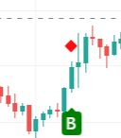
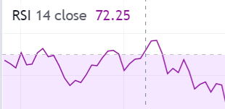
Potential Results
One of the possible three results will be provided to the user along with a confidence measure –
Buy
Sell
Neutral
Confidence Measure Range : 0 to 100

Slide 7
Discussion
We plan to employ proven technical indicators along with our model to make our decisions. Decision Trees could be used for this purpose and future scope could also involve using clustering techniques to group similarly trending assets to create a portfolio or diversify the risk.
Long-short term memory architecture has been found to be good for predictive analysis and this method could be experimented with our model to measure the results with classical techniques such as regression and SVM.

